Slide 1
Data Science
Introduction to Hadoop Distributed File System
HDFS

Slide 2
Agenda
Previous Day Recap
Previous Day Recap
What is HDFS?
What is HDFS?
Accessing HDFS
Accessing HDFS
Basic HDFS Commands
Basic HDFS Commands
Examples and Exercises
Examples and Exercises
HDFS Administration Tasks
HDFS Administration Tasks
Q&A
Q&A
HDFS Project
HDFS Project

Slide 3
Agenda
Previous Day Recap
Previous Day Recap
What is HDFS?
Accessing HDFS
Basic HDFS Commands
Examples and Exercises
HDFS Administration Tasks
Q&A
HDFS Project

Slide 4
Agenda
Previous Day Recap
What is HDFS?
What is HDFS?
Accessing HDFS
Basic HDFS Commands
Examples and Exercises
HDFS Administration Tasks
Q&A
HDFS Project

Slide 5
What is HDFS? Hot Dogs For Sale?
HDFS = Hadoop Distributed File System
Recall what is meant by distributed file system
It is the primary storage system for Hadoop applications (where data files reside)
HDFS provides high performance access to data across the Hadoop cluster
This storage layer can then be acted upon via all other components of the Hadoop Ecosystem

Slide 6
What is HDFS?
Name and Data Nodes
HDFS is the Scalable file system that Distributes and Stores Data across All machines in a Hadoop cluster
Fault Tolerance:
The NameNode instructs data files to be split into blocks, each of which are Replicated Three times and stored on machines across the cluster.
DataNode:
Stores the files
NameNode:
Tracks and directs the storage of files on the cluster
Runs on “Slave Nodes” the majority of nodes in a cluster
Runs on a “Master Node”

Slide 7
What is HDFS?
Client Machine
Also included in the Hadoop Cluster are the Client Machines
These machines are not a NameNode nor a DataNode
The Client Machines are responsible for Utilising the hadoop cluster
They Load Data, Submit Jobs and then View Results

Slide 8

The Hadoop Ecosystem
What is HDFS?
SPARK
OOZIE
ZOOKEEPER
Hadoop
MapReduce/ YARN
(Distributed Processing Framework)
PIG
FLUME
HDFS
(Hadoop Distributed File System)
MAHOUT
HIVE
SQOOP
Notes:
HDFS is the “secret sauce” that enables Hadoop to store huge files. It’s a scalable file system that distributes and stores data across all machines in a Hadoop cluster.
MapReduce is the system used to efficiently process the large amount of data Hadoop stores in HDFS.
MapReduce jobs are often written in Java. But not everyone using Hadoop knows Java—the preferred syntax is SQL, which is essentially the “lingua franca” between all programming languages in the BI/big data space.
Hive allows users who aren’t familiar with programming to access and analyze big data in a less technical way, using a SQL-like syntax called Hive Query Language (HiveQL). HiveQL is used to create programs that run just like MapReduce would on a cluster.
Like Hive and Impala, Pig is a high-level platform used for creating MapReduce programs more easily. The programming language Pig uses is called Pig Latin, and it allows you to extract, transform and load (ETL) data at a very high level—meaning something that would require several hundred lines of Java code can be expressed in, say, 10 lines of Pig.
While Hive and Impala require data to be more structured in order to be analyzed, Pig allows you to work with unstructured data. In other words, while Hive and Impala are essentially query engines used for more straightforward analysis, Pig’s ETL capability means it can perform “grunt work” on unstructured data, cleaning it up and organizing it so that queries can be run against it.

Slide 9
Agenda
Previous Day Recap
What is HDFS?
Accessing HDFS
Accessing HDFS
Basic HDFS Commands
Examples and Exercises
HDFS Administration Tasks
Q&A
HDFS Project

Slide 10
Loading HDFS
Accessing HDFS
So, now we have an appreciation for HDFS and what it is, lets jump in and start using it.
Load and log in to your Ubuntu instance port -1 for first login and 5910 when re-logging in without restarting.
And open the terminal
First we need to make ourselves
the hadoop super user
To start our hadoop services
To stop our hadoop services
Ctrl + Alt + t
su hduser
start-all.sh
stop-all.sh
Notes:
We need hduser, because of hosting hadoop on the localhost, which requires accessing privileged files and areas.
As hduser you have full rights but be warned, this is dangerous!!!!!
Ignore the depreciation warning, it is fine.

Slide 11
Quick Access Test
Accessing HDFS
A quick test to verify that HDFS has loaded is to view the file structure or display the contents of a directory.
Pulling up the user help guide is also generally a good test and helpful besides.
hdfs dfs -ls /user
hdfs dfs -lsr /user/testhue
hdfs dfs -help
hdfs dfs –help ls

Slide 12
Agenda
Previous Day Recap
What is HDFS?
Accessing HDFS
Basic HDFS Commands
Basic HDFS Commands
Examples and Exercises
HDFS Administration Tasks
Q&A
HDFS Project
Notes:
https://www.hdfstutorial.com/hdfs-commands/

Slide 13
Basic HDFS Commands
Create Your Storage Repository
In order to put data into hdfs we need a directory for our data to land in.
You can use this whenever you need a new directory.
Make a personal storage repository within hdfs for the data.
Do you see the trend for using hdfs?
hdfs dfs –mkdir /path/to/newdirectory
hdfs dfs –mkdir /user/your.name/demo
touchz filename
touchz data.csv
Notes:
Hdfs commands are unix commands prefixed with “hdfs dfs -”
So try something like: hdfs dfs –touchz /user/your.name/demo/filename

Slide 14
Basic HDFS Commands
Data Ingestion
Now that we have somewhere to put the data, lets put some data in there!
For this we can use the put command
This allows data to be transferred from the local system into hdfs
We can also use the copyFromLocal command
hadoop fs –put path/in/local /path/in/hdfs
hadoop fs –put /home/your.name/Desktop/data.csv /user/your.name/demo
hdfs dfs -copyFromLocal path/in/local
hdfs dfs –copyFromLocal /home/your.name/Desktop/data.csv
Notes:
These are similar but: copy from local is limited to the local source, also less control as to where the data lands in hdfs (use put)

Slide 15
Basic HDFS Commands
Data Extraction
In the same way we can put data in, we can take data out!
For this we can use the get command
This allows data to be transferred from the local system into hdfs
We can also use the copyToLocal command
hadoop fs –get /path/in/hdfs path/in/local
hadoop fs –get /user/your.name/demo/data.csv /home/your.name/Desktop
hdfs dfs -copyToLocal path/in/local
hdfs dfs –copyToLocal /home/your.name/Desktop
Notes:
These are similar but: copy to local is limited to the local destination, also less control in getting the file (use get)

Slide 16
Basic HDFS Commands
File System Organisation
So far, we have copied data to and from our local file system and HDFS.
We can also copy files within only HDFS
This is useful for creating backups, archiving and auditing our data.
Similar to Unix, you can use cp to rename the file
hdfs dfs –cp from/filename to/filename2
hdfs dfs –cp /user/your.name/data.csv /user/your.name/dataBackup/data.csv
hdfs dfs –cp /user/your.name/data.csv /user/your.name/dataBackup/cooldata.csv

Slide 17
Basic HDFS Commands
File System Organisation
It’s great to copy files, what about when we don’t want or need a duplicated copy of the file?
mv is the way to go, this moves the file, leaving you with just the 1 file
moveFromLocal is very similar to the put command, except that the local file is deleted after it’s copied
hdfs dfs –mv filename /newdirectory/filename
hdfs dfs –mv /user/your.name/data.csv /user/your.name/newdir/data.csv
hdfs dfs –moveFromLocal /path/in/local /path/in/hdfs
hdfs dfs –moveFromLocal /home/your.name/Desktop/data.csv /user/your.name/data/data.csv

Slide 18
Basic HDFS Commands
File Content & Location
Cats are clever animals
Here they allow you to read the contents of a file
You can also use them to copy the source pate to the stdout
hdfs dfs –cat filename
hdfs dfs –cat /user/testhue/hdfs/hdfs1/appl_daily.csv
hdfs dfs –cat URI
hdfs dfs –cat file:///cooldata.csv /user/your.name/data.csv

Slide 19
Basic HDFS Commands
Data File Deletion
Recall from unix that rm removed a file and rm –r removed a directory recursively.
Well this is not quite the case with hdfs……
This removes the file to the “Trash” and therefore recoverable.
To delete the “Trash” we expunge.
Now the file will be permanently deleted.
hdfs dfs –rm –r path/to/directoryOrFile
hdfs dfs –expunge

Slide 20
Basic HDFS Commands
File Test
There are tests that can be performed on a file.
These prove useful to see if a file exists, has length or is in a directory.
-e checks file existence, returning 0 if true.
-z checks if the file is zero length, returning 0 if true.
-d checks to see if the path is directory, returning 0 if true.
hdfs dfs -test -[ezd] URI
hdfs dfs -test -e filename
Notes:
echo $?

Slide 21
Basic HDFS Commands
File Access Control
Change permissions of the file
Chmod:
Change the group associated with the file
Chgrp:
Change the owner of the file
Chown:
hdfs dfs –chmod 777 /user/your.name/data.csv
hdfs dfs –chgrp newGroup /user/your.name/data.csv
hdfs dfs –chown newOwner /user/your.name/data.csv

Slide 22
Basic HDFS Commands
File Statistics
Counts the number of directories, files, and bytes under the path specified
Displays the size of the specified file, or the sizes of files and directories
Returns the stat information on the path
hdfs dfs –count /user/your.name/data.csv
hdfs dfs –du -s /user/your.name/data.csv
hdfs dfs –stat /user/your.name/data.csv

Slide 23
Agenda
Previous Day Recap
What is HDFS?
Accessing HDFS
Basic HDFS Commands
Examples and Exercises
Examples and Exercises
HDFS Administration Tasks
Q&A
HDFS Project

Slide 24
HDFS – Exercise 1
Stock Data Ingestion Task
Duration - 30 minutes.
Complete Section 1: Exercise 1 of the HDFS and MapReduce workbook.
Notes:
/PublicStorage/datasets
Backup copies exists in /home/stuart.brown/Desktop/datasets

Slide 25
Agenda
Previous Day Recap
What is HDFS?
Accessing HDFS
Basic HDFS Commands
Examples and Exercises
HDFS Administration Tasks
HDFS Administration Tasks
Q&A
HDFS Project

Slide 26

HDFS Administration Tasks
Administration in an important aspect in overseeing your Hadoop Cluster
Typical Administration Tasks Involve:
Verifying the Overall Health of Your Cluster
Cluster Balancing
Checking Log Files
Managing the Clusters Nodes
Administration Tasks of HDFS
Administration Tasks of MapReduce
Monitoring the Performance of Trackers
All Good!
ADMIN
Notes:
Be aware that many of the admin tasks wont work as we are only using a pseudo cluster.

Slide 27
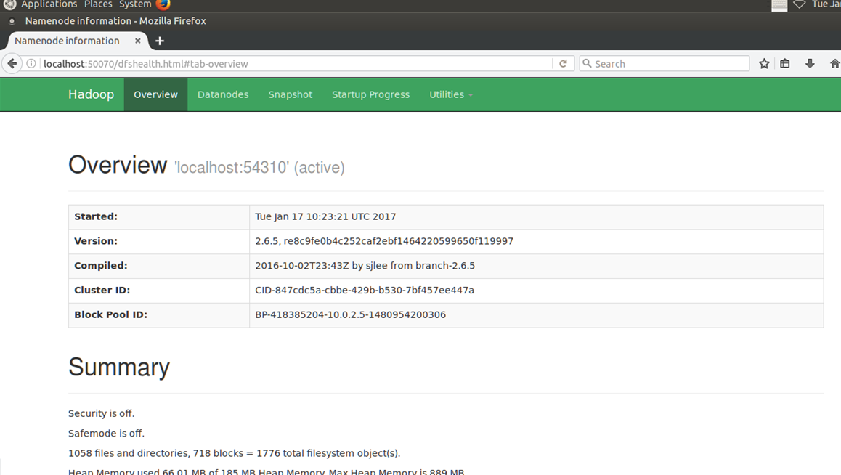
HDFS Administration Tasks
Cluster Health Overview
Once you have started your hadoop services the first Administration task is to check the health of your cluster.
localhost:50070
Notes:
Demonstrate the tabs and the information they display:
Overview – Summary and NameNode
Datanode – Datanode Information
Startup Progress -

Slide 28
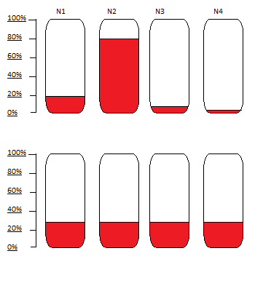
HDFS Administration Tasks
Cluster Balancing - Not All Nodes Were Created Equal
Some nodes are faster (processing and memory)
than others, some are more stable, while others
have more storage space available to them.
Meaning that some nodes are favourably written
to.
In turn creating a bottle neck of data
processing/access.
Fortunately we can rebalance the cluster to free
up these desirable nodes .
hadoop balancer –threshold 30
hdfs balancer [-threshold <threshold>]

Slide 29
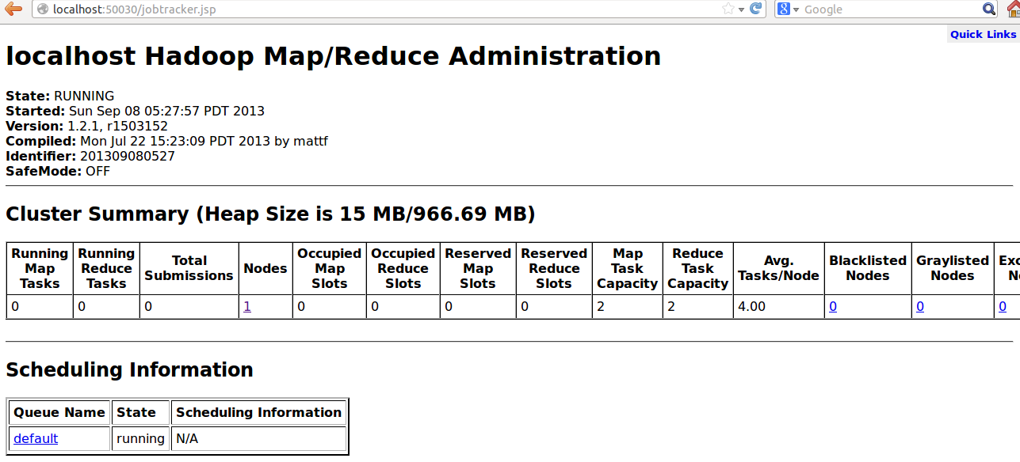
HDFS Administration Tasks
Daemon Logs
With our services or daemons running we may need to check their log files.
Hadoop daemons generate log files that can help you determine what’s happening on the cluster.
We can use the daemonlog to generate logs for us at different levels.
Syntax:
hdfs daemonlog -setlevel <host:port> <name> <level>
Example:
hdfs daemonlog -setlevel 10.250.1.15:50030 org.apache.hadoop.mapred.JobTracker DEBUG

Slide 30
HDFS Administration Tasks
DataNode
DataNodes store the data
We can run a data node on its own to verify its status
Occasionally if the cluster fails to update, the data nodes will need to be rolled back before updating again.
DATA NODE OPTIONS
Regular = Start the Data Node Normally
Rollback = Rollback the Data Node to the Previous Version
Ensure the Dana Nodes have been stopped and the old Hadoop version has been distributed before using this!
Syntax:
hdfs datanode <option>
Example:
hdfs datanode -regular
Rollingupgraderollback = rollback a rolling upgrade operation

Slide 31
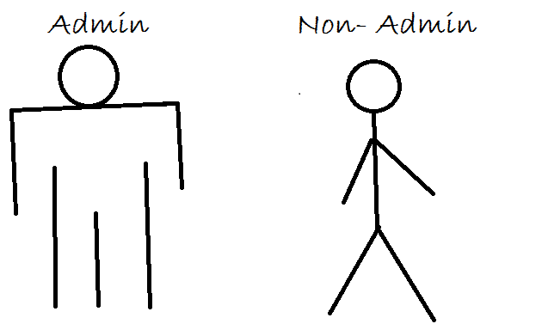
HDFS Administration Tasks
dfsadmin
This is the most extensive administration command available.
This runs the HDFS dfsadmin client
To vies all available commands, use:
Hdfs dfsadmin –help
To see the full list:
https://hadoop.apache.org/docs/current/hadoop-project-dist/hadoop-hdfs/HDFSCommands.html#dfsadmin

Slide 32
HDFS Administration Tasks
mradmin
Runs a number of MapReduce administrative operations.
Use the -help option to see a list of all supported options.
refreshServiceAcl, reloads the service-level authorization policy file
refreshUserToGroupsMappings refreshes user-to-groups mappings
refreshQueues reloads the queue access control lists (ACLs) and state
refreshSuperUserGroupsConfiguration refreshes superuser proxy groups mappings
Syntax: hadoop mradmin <option> [<option>]
Example: hadoop mradmin -help –refreshNodes
refreshNodes refreshes the hosts information at the JobTracker

Slide 33
HDFS Administration Tasks
NameNode
The Name Node co-ordinates the storage for the entire Hadoop Cluster.
We can run the name node on its own to verify its status.
It is important to utilise these, especially if an update/upgrade to the hadoop cluster has occurred.
If the Name Node goes down, all is not lost provided you have a secondarynamenode
rollback, the NameNode is rolled back to the previous version (remember to stop the cluster and distribute the previous Hadoop version before using this option)
format, the NameNode is started, formatted, and then stopped
upgrade, the NameNode starts with the upgrade option after a new Hadoop version is distributed
importCheckpoint, an image is loaded from the checkpoint directory and saved into the current directory.
Syntax: hadoop namenode [-format] | [-upgrade] | [-rollback] | [-finalize] | [-importCheckpoint]
Example:hadoop namenode –finalize
finalize, the previous state of the file system is removed, the most recent upgrade becomes permanent, rollback is no longer available, and the NameNode is stopped

Slide 34
HDFS Administration Tasks
Keeping Track of Trackers
The jobtracker node co-ordinates the data processing system for the hadoop cluster.
We can run this node on its own to verify its status.
For instance if we wanted to find out what the configuration is for the Job Tracker we can use:
The tasktracker node co-ordinates the job processing tasks for the hadoop cluster.
We can run this node on its own to verify its status.
To find out more about tasktracker we can use:
hadoop jobtracker –dumpConfiguration
hadoop tasktracker -help

Slide 35
HDFS
Extra User Commands
hdfs classpath [--glob |--jar <path> |-h |--help] returns the classpath for the Hadoop Jar
hdfs dfs [COMMAND [COMMAND_OPTIONS]] Run a filesystem command on the file system supported in Hadoop
hdfs envvars display computed Hadoop environment variables
hdfs fetchdt <opts> <token_file_path> Gets Delegation Token from a NameNode
hdfs fsck <path> [-list-corruptfileblocks |
[-move | -delete | -openforwrite]
[-files [-blocks [-locations | -racks | -replicaDetails | -upgradedomains]]]
[-includeSnapshots] [-showprogress]
[-storagepolicies] [-blockId <blk_Id>] Runs the HDFS filesystem checking utility
hdfs getconf [-namenodes |-secondaryNameNodes |-backupNodes |-includeFile |-excludeFile |-nnRpcAddresses |-confKey [key]] Gets configuration information from the configuration directory, post- processing
hdfs groups Returns the group information given one or more usernames
hdfs version Prints the version
Notes:
Not essential but good to be aware of
HDFS supports the fetchdt command to fetch Delegation Token and store it in a file on the local system. This token can be later used to access secure server (NameNode for example) from a non secure client.

Slide 36
HDFS – Exercise 2
HDFS
Duration - 30 minutes.
Prepare a 5~10 minute presentation to the group.
It should at least cover:
What HDFS is
How it relates to Hadoop
How it handles the flow of data

Slide 37
Agenda
Previous Day Recap
What is HDFS?
Accessing HDFS
Basic HDFS Commands
Examples and Exercises
HDFS Administration Tasks
Q&A
Q&A
HDFS Project

Slide 38

😩😩😩 😎
So, do you have any questions for me?
Notes:
Not essential but good to be aware of

Slide 39
Agenda
Previous Day Recap
What is HDFS?
Accessing HDFS
Basic HDFS Commands
Examples and Exercises
HDFS Administration Tasks
Q&A
HDFS Project
HDFS Project

Slide 40
HDFS – Project
HDFS Project
Duration – 2 Interspersed Days.
Complete Section 1 Exercise 2 of the HDFS and MapReduce workbook.
Notes:
Create a script that will transfer data files into hdfs.
This script should place existent, sized files into an individually appropriate directory on hdfs based on the file name.
Status messages and flow control should also be included.
An archive of the files should also be created.

Slide 41
Learning Outcome?
Describe what HDFS is and where is sits within the hadoop ecosystem.
Describe what NameNodes and DataNodes are, what they do and where they fit into HDFS.
Load and Access HDFS from the terminal.
Perform basic HDFS operations to manage data files.
Understand the basics of the HDFS Administration Tasks.

